Slide 1
Carrier Trading Center
Supervisor: Mr. Nguyễn Văn Sang
Lê Văn Dương
Trịnh Đình Quyết
Vũ Văn Quyết
Lê Gia Hoàng
Đặng Lê Tuấn

Slide 2
Presentation Outline
Project Overview
Project Management
Software Specification
Software Design
Testing
Project Result
Demo

Slide 3

Project Overview
Current Situation
Current situation
The ideas
The objectives

Slide 4
Project Overview
Current situation
Current situation:
Nowadays, in our country, which is a developing country, transportation becomes more and more popular because of the rising of economy.
But according to survey, there are 83% trucks and containers with empty cargo on return. Which mean they are only deliveries one-way.
A LOT OF EMPTY CONTAINER TO FILL WITH GOODS AND CARGOES TO DISTRIBUTE

Slide 5
Project Overview
Current situation
Transporter has to find customer to delivery goods on the way return
Meeting to take goods and confirmation contract money, time and place of destination
There lots of outcomes will happens:
Trading successfully
Trading failed
Trading cancel with no compensation
CARRIER AND GOODS OWNER NEEDS AN INTERMEDIATE BETWEEN THEM TO MAKE CONTRACTS

Slide 6
Project Overview
Current Situations
Technology Trends
Nowadays, more and more people using internet to work and to do things related with their work and their job
In Vietnam, which is a developing country, economy still growing strong and it’s easier for business websites
Users using internet also increases more and more because of internet services and technical upgrade and demanding from customers keep rising
Internet is the fastest and easiest ways to communicate and connect people who require service and who bring service

Slide 7
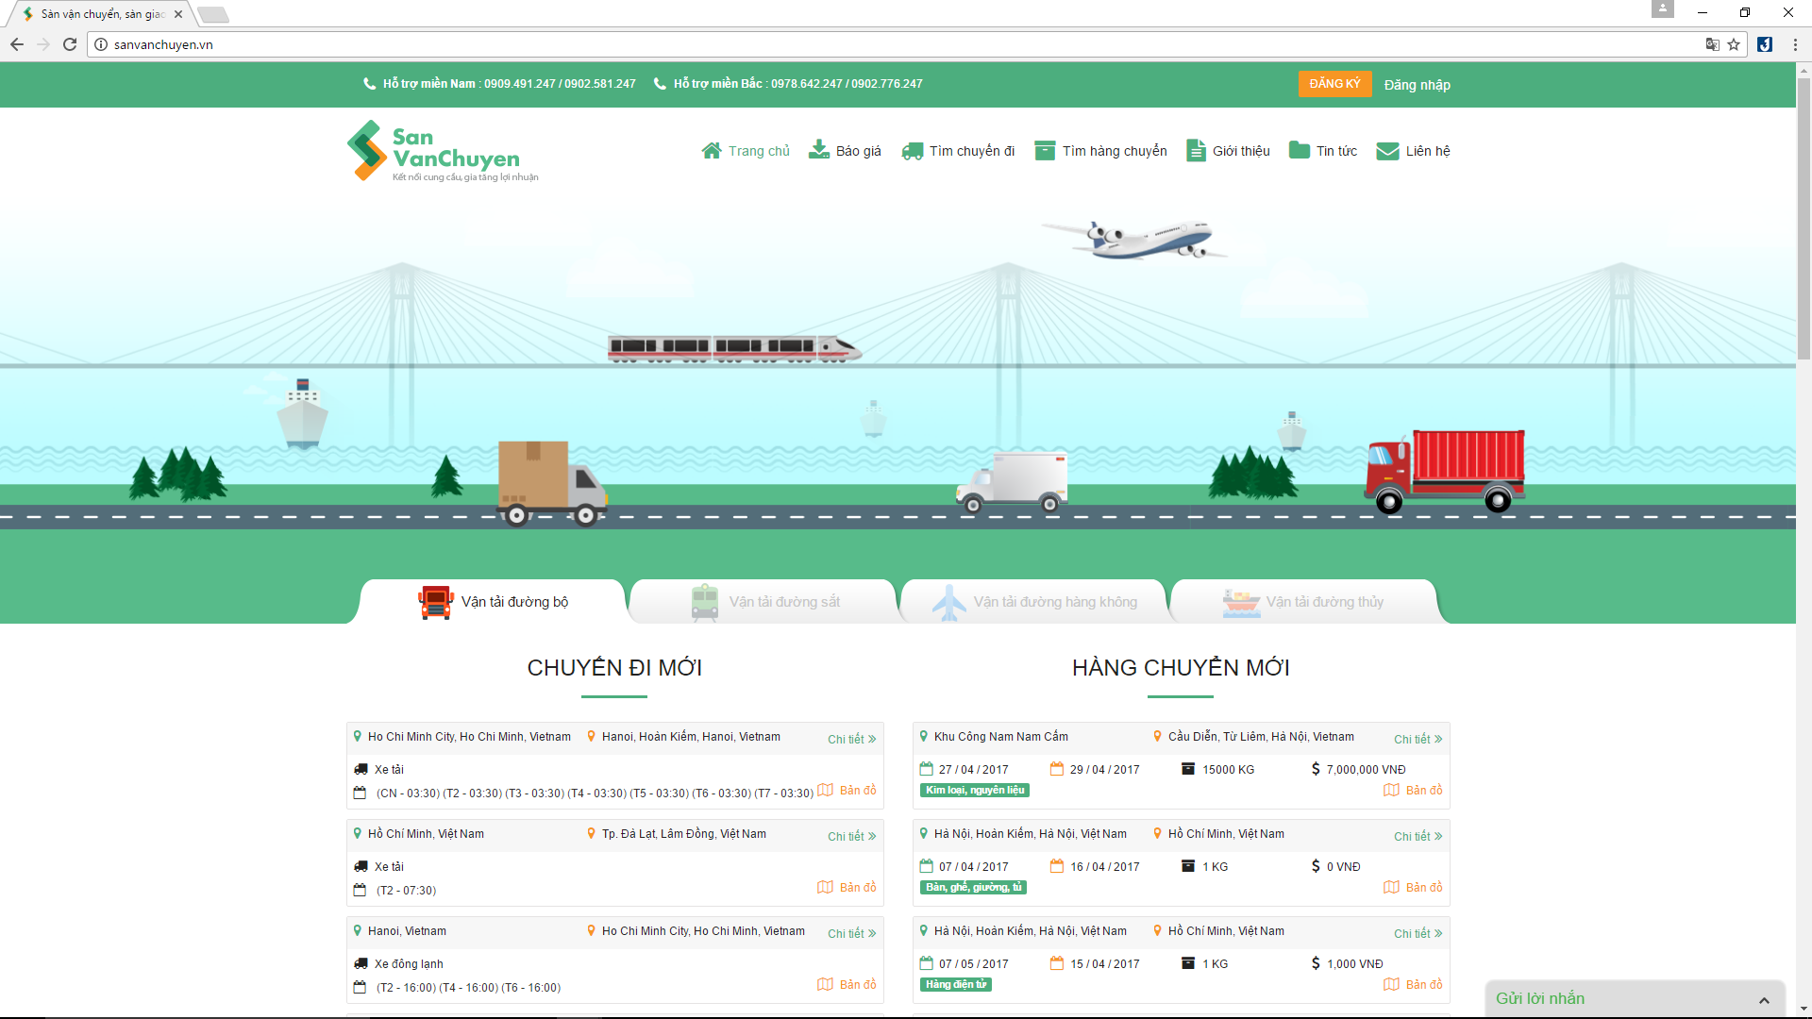
Project Overview
Current Situations
Current Application Limitation
Advantage:
Friendly with user
Easy-to-use
Lots of ways to transportation
Disadvantage:
Easy for scammer and phishing
Information about users not clearly and detail enough
Trust issues when making transactions
sanvanchuyen.vn

Slide 8
Project Overview
The Ideas
Carrier Trading Center:
Create a web application that connect Goods Owner and Carrier
With minimum costs
Solve problems for people who owns goods and people who distributes goods can transaction with each other through an intermediate

Slide 9
Project Overview
Objectives
Fulfill requirements from FPT University
Develop a product that expressed the above ideas
Study new technologies: JSF framework, Hibernate framework, etc.
Apply project development and software process
Practical ways of working in groups
Have skills in communication, time management, risk management etc.

Slide 10
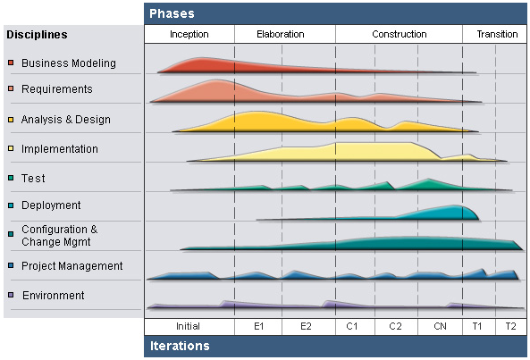
RUP Model
Project Management
Project Model
Inception
Elaboration
Construction
Transition

Slide 11
Develop iteratively
Project Management
Project Model
Supports an iterative approach to development that addresses the highest risk items at every stage in the lifecycle, significantly reducing a project’s risk.
Manage requirements
Managing requirements during the whole development process ensures project team develops the right system with right requirements
Verify software quality
Very important for inexperienced team in controlling issues like us.
Testing process is implemented in all the cycles of application development time
Reduce risks

Slide 12
Project Management
Initiation
Study business case and feasibility study of project
Complete draft ERD of system
Complete draft screen prototypes
Complete draft requirements
Determine project scopes
Complete project management plan

Slide 13
Project Management
Solution
Complete user requirement specification
Complete software requirement specification
Complete ERD, final prototypes
Complete database model
Complete system architecture design

Slide 14
Project Management
Construction & Transition
Construction:
Complete coding and unit test
Complete functional and regression test
Complete user manual
Transition:
Deploy website
Deliver source code
Complete all reports and documents

Slide 15
Project Management
Organization Structure
Nguyễn Văn Sang
Instructor
Lê Văn Dương
Project Manager
Vũ Văn Quyết
Technical Leader
Đặng Lê Tuấn
Developer
Đặng Lê Tuấn
Tester
Trịnh Đình Quyêt
Developer
Trịnh Đình Quyết
Test Leader/QA
Lê Văn Dương
Developer
Lê Gia Hoàng
Developer
Đặng Lê Tuấn
Design Leader
Lê Gia Hoàng
Designer

Slide 16
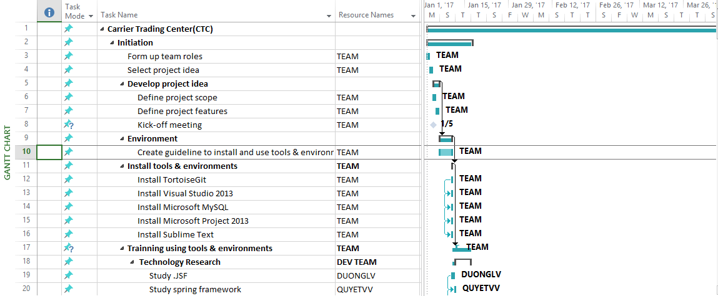
Project Management
Master Schedule

Slide 17
Project Management
Objectives
Metrics | Unit | Committed | Actual | Deviation
Start Date | dd-mm-yyyy | 03-01-2017 | 03/01/2017 | 0 days
End Date | dd-mm-yyyy | 19-04-2017 | 19-09-2017 | 0 days
Duration | Elapsed days | 105 days | 105 days | 0 days

Slide 18
Project Management
Deliverables
No | Stage | Deliverable/ Milestone | Delivery Date | Delivery Location
1 | Initiation | Deliver Report No.1 | 09/01/2017 | Supervisor
3 | Initiation | Deliver Report No.2 | 16/01/2017 | Supervisor
4 | Solution | Software Requirement Specification | 10/02/2017 | Supervisor
5 | Solution | System Architectural Design | 24/02/2017 | Supervisor
6 | Construction | Complete Coding | 18/03/2017 | Supervisor
7 | Construction | Deliver Report No.5 | 24/03/2017 | Supervisor
8 | Construction | Deliver Report No.6 | 17/04/2017 | Supervisor
9 | Termination | The last Document and CD source code | 19/04/2017 | FU
10 | Termination | Project completed | 26/04/2017 | FU

Slide 19








Project Management
Tools & Environment

Slide 20



Project Management
Technical

Slide 21
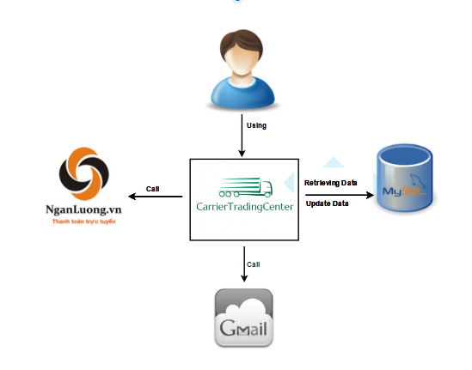
Software Specification
System Overview

Slide 22
Software Specification
Functional Requirement
Guest
Administrator
Carrier
Goods owner

Slide 23
Software Specification
Functional Requirement
Register
Bill of lading list
Guest
Fee list

Slide 24
Software Specification
Functional Requirement
Bill of lading list
Manage user
Fee list
Administrator
Transaction history
Manage report
Login/Logout
Manage profile
Account recharge for user

Slide 25
Software Specification
Functional Requirement
Bill of lading list
Manage profile
Fee list
Carrier
Transaction history
Manage report
Login/Logout
Connect to goods owner
Account recharge

Slide 26
Software Specification
Functional Requirement
Bill of lading list
Manage profile
Fee list
Goods owner
Transaction history
Manage report
Login/Logout
Connect to carrier
Account recharge

Slide 27
Software Specification
Non-functional Requirement
Reliability
Performance
Security

Slide 28
Software Specification
Non-functional Requirement
Mean time between failure: 500 hours using
Reliability
Maximum 1 bug per 1 function in 2 months
Available 99% of time
Performance
Response time < 5s

Slide 29
Software Specification
Non-functional Requirement
Correct email
Sensitive information is stored in md5 format in database
Security
Using access control
Sensitive information is encrypted before transmission
Use SSL certificate number

Slide 30
Software Design
Architecture Presentation
Package Design
Design Description
Database Design
Detail Design flow

Slide 31
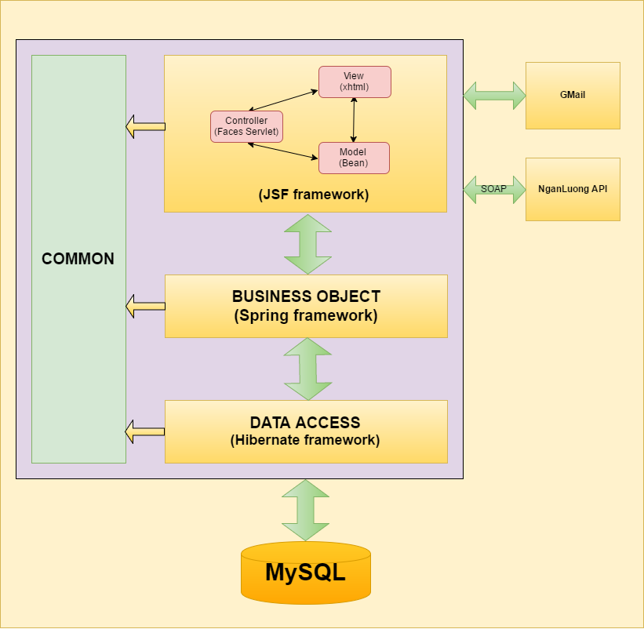
Software Design
Architecture Presentation

Slide 32

Extensible UI component model.
Extensible conversion and validation model.
Swing-like object-oriented Web application development.
Flexible rendering model.
Backing-bean management.
Why choose
JSF?

Slide 33
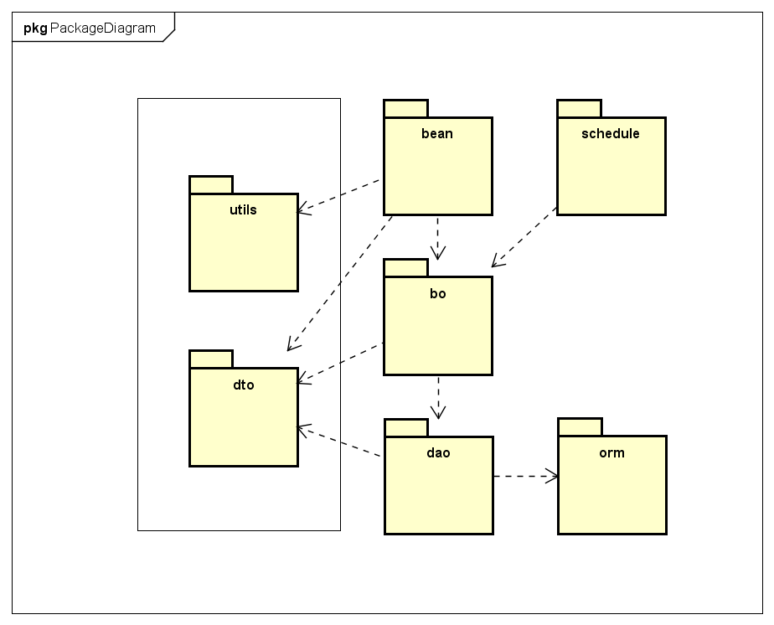
Software Design
Package Design

Slide 34
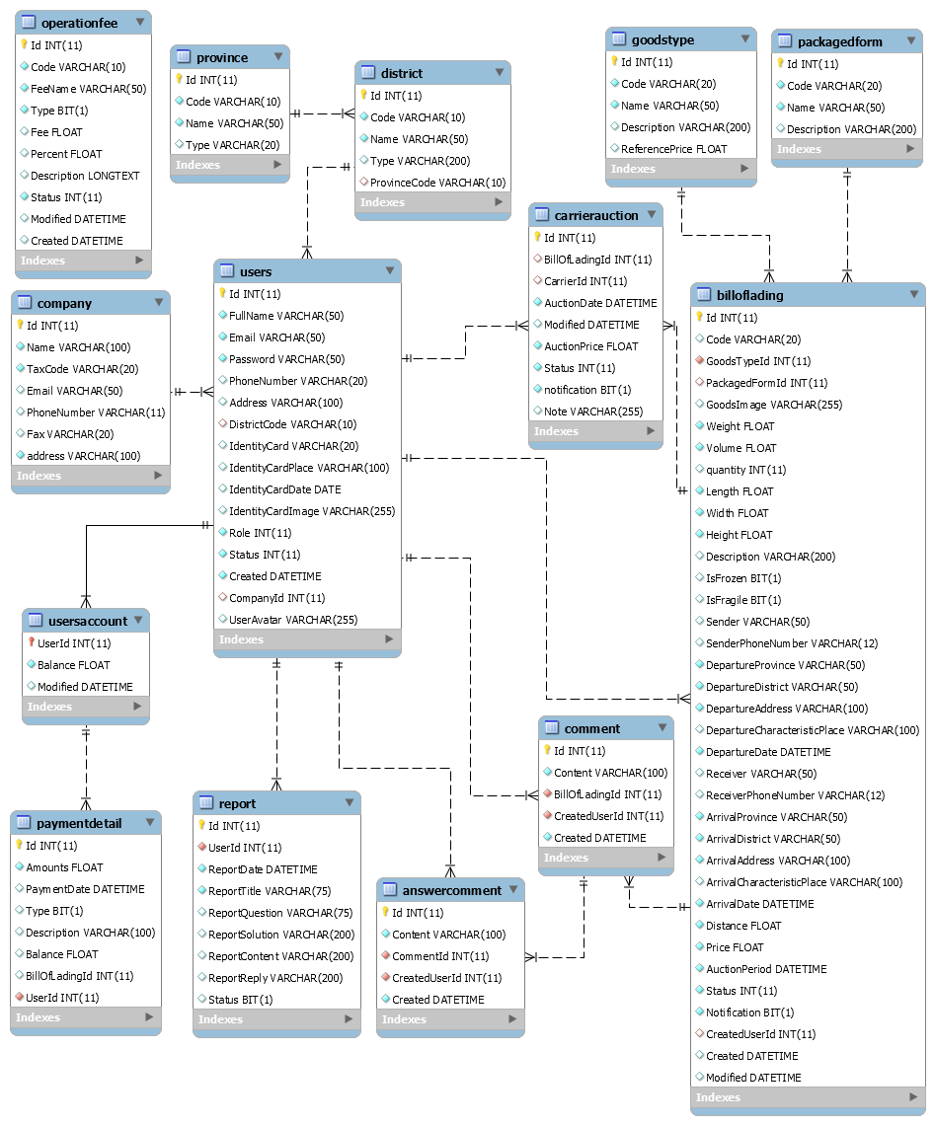
Software Design
Database Design

Slide 35
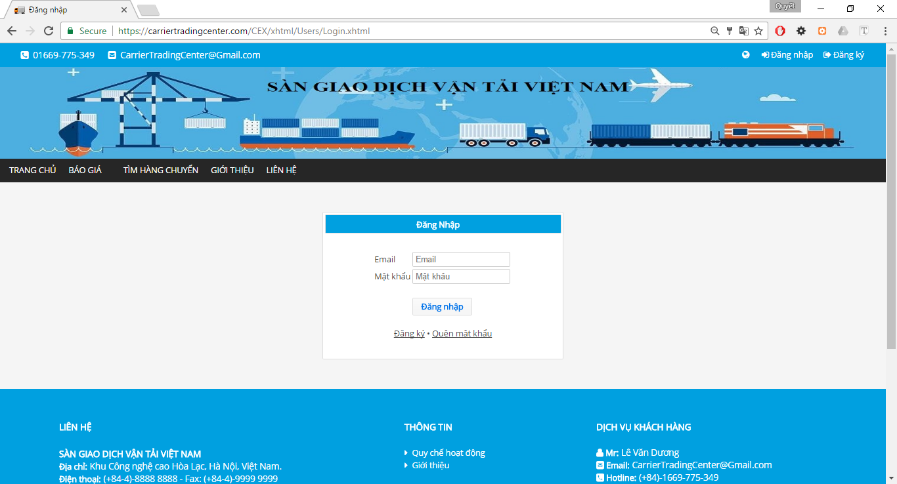
Software Design
Detail Design Flow
Screen Design
No | Object/Control Name | Object/Control Name in English | Type | Required | Length | Description
1 | Email | email | inputText | Yes
2 | Mật khẩu | password | password | Yes
3 | Đăng nhập | login | commandButton
4 | Đăng ký | register | href link
5 | Quên mật khẩu | forgotPassword | href link
Screen for Login

Slide 36
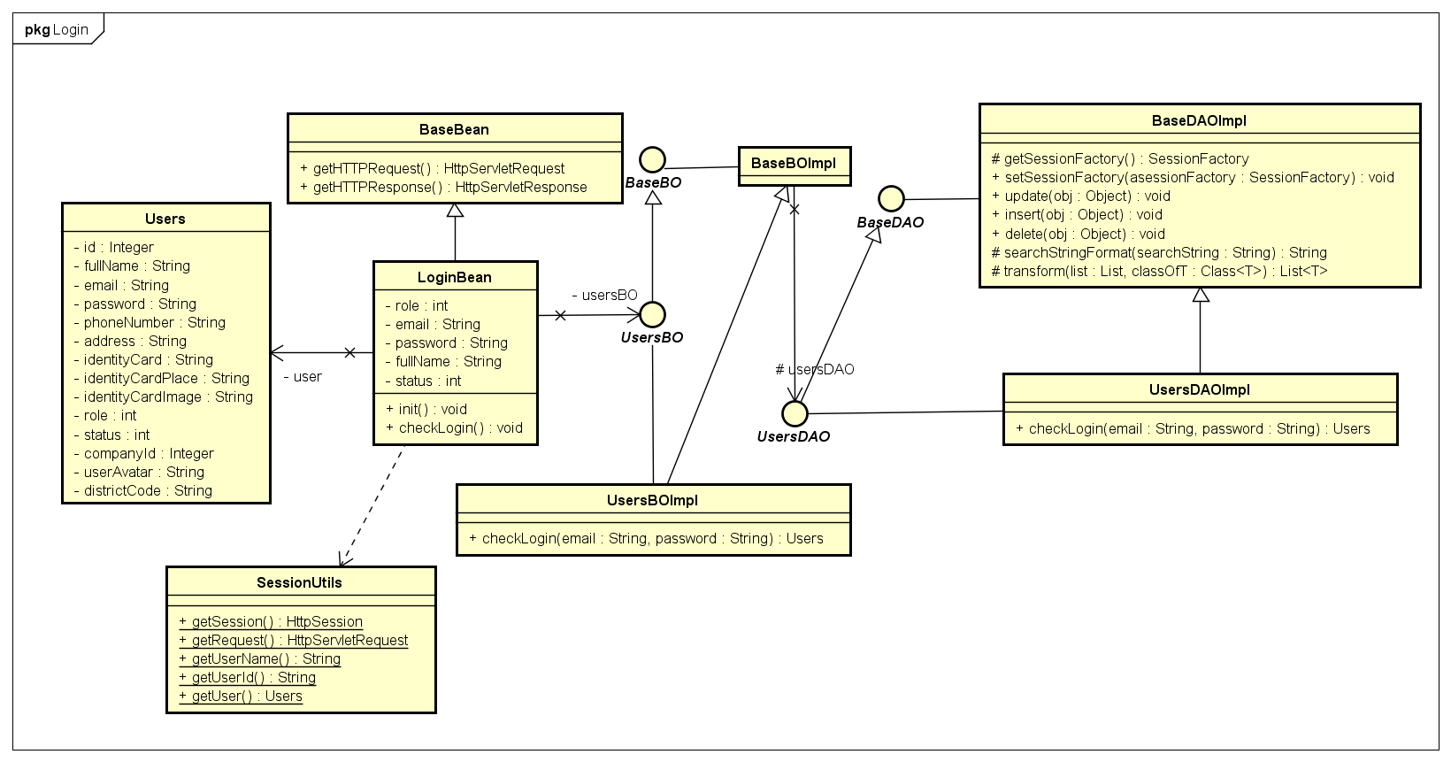
Software Design
Detail Design Flow
Class Diagram
Login Class Diagram

Slide 37
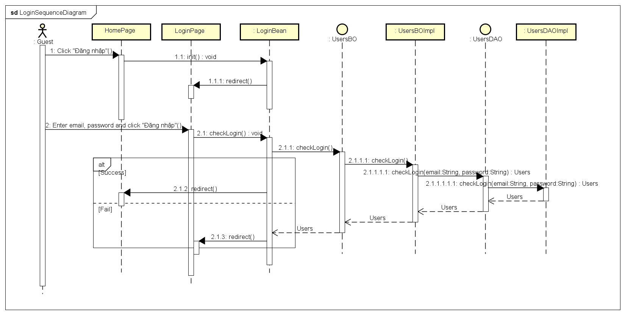
Software Design
Detail Design Flow
Sequence Diagram
Login Sequence Diagram

Slide 38
Testing
Test Model
Customer requirement
validate
Acceptance test
Product specifications
verify/validate
System test
High-level design
verify
Integration test
other V&V activities
Low-level design
verify
Component test
Coding & unit test

Slide 39
Testing
Test Model
Why choose V-model?
Simple and easy-to-use
Testing activities like planning, test designing happens well before coding
Proactive defect tracking
Avoids the download flow of the defects

Slide 40
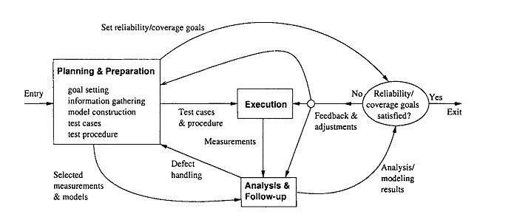
Testing
Test Process

Slide 41
Software Specification
Test Process
Goal settings: test stages, test items etc.
Planning & Preparation
Response time < 5s
Executing test
Execution
Related activities: retest, report etc.
Checking result
Analysis & Follow-up
Analysis result
Initiating & Monitoring

Slide 42
Software Specification
Test Schedule
Doer: developer team
Unit test
Time: 24/02 – 18/03
Doer: test team
Integration test
Time: 19/03-24/03
System test
Doer: Test team
Time: 24/03 – 10/04

Slide 43
Testing
Test Environment & Resources
Environment:
Name | Purpose | Detail
PC/Laptop | Real device testing | RAM: 4Gb Hard disk: 500Gb Processor: Core i5 2.50 GHz Web browser: Chrome 57.0, Firefox 53.0
Resources:
Member | Position | Responsibilities
Trịnh Đình Quyết | Test Leader | Create test plan Review test cases Execute test Review test report
Đặng Lê Tuấn | Tester | Create test cases Execute test Create test report

Slide 44
Testing
Test Result
No | Module | Integration test |  |  |  | System test and check List |  |  |  | Total
 |  | Yes | No | Untested | N/A | Yes | No | Untested | N/A
1 | Guest | 60 | 0 | 0 | 0 | 189 | 0 | 0 | 18 | 267
2 | Carrier | 192 | 0 | 0 | 0 | 1051 | 0 | 0 | 74 | 1317
3 | Goods Owner | 148 | 0 | 0 | 0 | 778 | 0 | 0 | 60 | 986
4 | Admin | 90 | 0 | 0 | 0 | 689 | 0 | 0 | 60 | 839
5 | Total | 490 |  |  |  | 2707 |  |  | 212 | 3409
Test coverage: 100%
Test case pass: 100%

Slide 45
Project Result
Compilation Result
Main objectives | Create a web application that connect Goods Owner and Carrier with to minimize transportation costs.
Purpose | Create a new system in circumstance there is no similar system exists.
Items | Plan | Actual
Releases date | 05/05/2017 | 05/05/2017
Releases version | 1.0 | 1.0
Days | 105 | 105
Test cases + checklists | 2000 | 2919
Defects | 100 | 56
Document pages | 400 | 461
Lines of code |  | Approximately ????

Slide 46
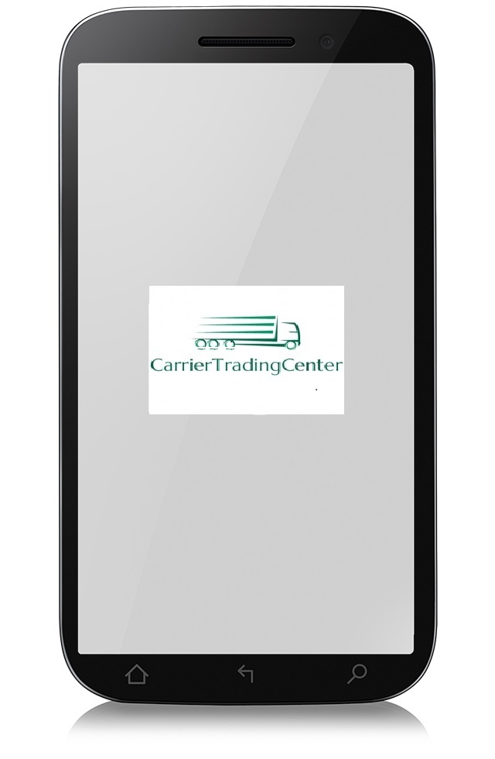

Project Result
Limitation & Expectation
Website doesn’t support for mobile user yet

Slide 47


Project Result
Limitation & Expectation
Not have live chat from support of Carrier Trading Center for guests and users

Slide 48


Project Result
Limitation & Expectation
Only supported Vietnamese on website

Slide 49


Project Result
Lesson Learned
Asking other for helping when stressed, troubled when deadline is coming closer.
Asking

Slide 50
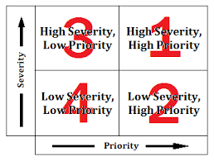

Project Result
Lesson Learned
Prioritize work and focus on something more important

Slide 51
Project Result
Limitation & Expectation
Doesn’t have mobile version to make it easier to access from anywhere

Slide 52
Project Result
Limitation & Expectation
Guest cannot have a live chat with supporter of Carrier Trading center

Slide 53
Project Result
Limitation & Expectation
Language used is only Vietnamese

Slide 54
Project Result
Lesson Learned
Asking other for helping when stressed, deadline is coming closer.
Asking

Slide 55
Project Result
Lesson Learned
Prioritize work, focus on something more important

Slide 56

Questions & answers

Slide 57

demo

